Slide 1

MAY 27, 2022
music popularity
SONG POPULARITY

Slide 2
Predicting high
popularity
scores

Slide 3
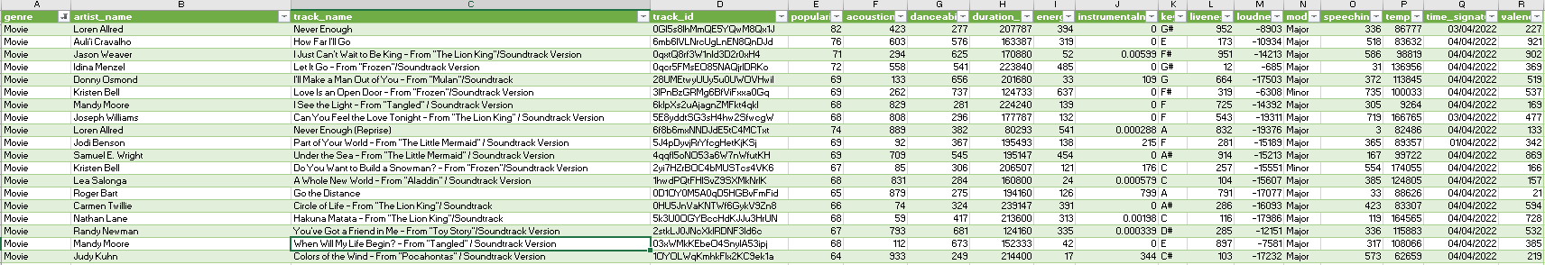
Sources
Wikipedia Spotify

Slide 4
Grouping
Feature | Opera | A Capella | Alternative | Blues | Dance | Pop | Electronic | R&B | Children's music | Folk | Anime | Rap | Classical | Reggae | Hip-Hop | Comedy | Country | Reggaeton | Ska | Indie | Rock | Soul | Soundtrack | Jazz | World | Movie
Acousticnesss |  |  |  |  | 0.053 |  |  |  |  |  |  |  | 0.18 |  |  |  |  |  |  | 0.058 |  |  |  |  |  | 0.084
danceability | -0.088 | 0.13 | 0.073 | 0.073 | 0.059 | 0.13 | 0.057 | 0.069 | 0.073 |  | 0.073 | 0.061 |  | 0.066 | 0.092 |  |  | 0.097 | 0.12 | 0.097 |  | 0.061 |  |  |  | -0.2
duration_ms |  | -0.28 |  |  | -0.085 |  |  |  |  |  |  |  |  |  |  | 0.068 |  |  | 0.16 |  |  |  | 0.069
energy | 0.052 |  |  |  |  |  |  | 0.051 |  | 0.057 |  |  | 0.14 |  |  | 0.19 | 0.053 | -0.08 | -0.083 | -0.073 |  |  |  | -0.073 |  | -0.12
instrumentalness |  | -0.053 |  |  |  | -0.064 | -0.075 | -0.064 |  | -0.059 |  |  | 0.15 | -0.055 |  |  |  |  | -0.062 | -0.076 | -0.071 |  |  | -0.14 | -0.098 | 0.088
liveness |  |  |  |  | -0.061 |  | -0.052 |  |  | -0.055 |  | -0.059 | -0.22 |  | -0.063 |  |  | -0.0853 | 0.052 |  |  | -0.068 |  | -0.051 |  | -0.066
loudness | 0.11 | 0.14 |  |  | 0.055 |  |  | 0.12 |  |  |  | 0.068 | 0.08 | 0.05 | 0.087 | 0.22 |  | 0.13 |  |  |  | 0.051 |  |  | 0.062
speechiness | -0.099 |  |  |  |  |  | -0.09 |  |  |  |  | -0.082 | -0.14 |  | -0.084 | -0.066 |  |  | -0.085 |  |  |  |  |  | -0.069 | -0.12
tempo |  | -0.16 |  |  |  |  |  |  |  |  |  |  |  |  |  |  |  |  |  | -0.053 |  |  |  |  |  | -0.063
valence |  | 0.18 | 0.066 | 0.066 |  |  |  |  | 0.066 |  | 0.066 |  |  |  |  | -0.12 | 0.052 | -0.066 |  |  |  |  |  | -0.061 | -0.056 | -0.21
 | Opera | A Capella | Alternative | Blues | Dance | Pop | Electronic | R&B | Children's music | Folk | Anime | Rap | Classical | Reggae | Hip-Hop | Comedy | Country | Reggaeton | Ska | Indie | Rock | Soul | Soundtrack | Jazz | World | Movie
Opera |  |  |  |  |  |  |  |  |  |  |  | 0.42 | 0.44 |  |  | 0.73 |  |  |  |  |  |  |  |  | 0.54
A Capella |  |  | 0.6 | 0.6 | 0.66 |  |  | 0.47 | 0.6 |  | 0.6 |  |  | 0.46
Alternative |  | 0.6 |  | 1 |  | 0.68 | 0.55 |  | 1 |  | 1 |  |  | 0.46 | 0.43 |  |  |  |  | 0.54 |  | 0.42
Blues |  | 0.6 | 1 |  |  | 0.68 | 0.55 |  | 1 |  | 1 |  |  | 0.46 | 0.43 |  |  |  |  | 0.54 |  | 0.42
Dance |  | 0.66 |  |  |  |  |  | 0.48 |  |  |  | 0.57 | 0.5 | 0.47 | 0.6 |  |  | 0.6 |  |  |  | 0.71
Pop |  |  | 0.68 | 0.68 |  |  | 0.71 | 0.55 | 0.68 |  | 0.68 | 0.41 |  | 0.84 | 0.5 |  |  | 0.42 | 0.54 | 0.73 | 0.52 | 0.51 |  | 0.54
Electronic |  |  | 0.55 | 0.55 |  | 0.71 |  | 0.59 | 0.55 | 0.5 | 0.55 | 0.77 |  | 0.69 | 0.77 |  |  |  | 0.57 | 0.49 | 0.48 | 0.57 |  | 0.42 | 0.61
R&B |  | 0.47 |  |  | 0.48 | 0.55 | 0.59 |  |  | 0.5 |  | 0.61 |  | 0.88 | 0.66 | 0.65 |  | 0.58 |  |  | 0.57 | 0.61 |  | 0.5 | 0.8
Children's music |  | 0.6 | 1 | 1 |  | 0.68 | 0.55 |  |  | 0.52 | 1 |  |  | 0.46 | 0.43 |  |  |  |  | 0.54 |  | 0.42
Folk |  |  |  |  |  |  | 0.5 | 0.52 |  |  |  |  |  |  |  | 0.41 | 0.56 |  |  |  | 0.58 | 0.4
Anime |  | 0.6 | 1 | 1 |  | 0.68 | 0.55 |  | 1 |  |  |  |  | 0.46 | 0.43 |  |  |  |  | 0.54 |  | 0.42
Rap | 0.42 |  |  |  | 0.57 | 0.41 | 0.77 | 0.61 |  |  |  |  | 0.56 | 0.58 | 0.99 | 0.48 |  | 0.69 |  |  |  | 0.8 |  |  | 0.52
Classical | 0.44 |  |  |  | 0.5 |  |  |  |  |  |  | 0.58 |  |  | 0.51 | 0.4 |  |  |  |  |  | 0.46 |  |  |  | 0.45
Reggae |  | 0.46 | 0.46 | 0.46 | 0.47 | 0.84 | 0.69 | 0.88 | 0.46 |  | 0.46 | 0.56 |  |  | 0.64 |  |  | 0.63 | 0.45 | 0.69 | 0.66 | 0.62 |  | 0.69 | 0.71
Hip-Hop |  |  | 0.43 | 0.43 | 0.6 | 0.5 | 0.77 | 0.66 | 0.43 |  | 0.43 | 0.99 | 0.51 | 0.64 |  | 0.46 |  | 0.74 |  |  |  | 0.83 |  |  | 0.52
Comedy | 0.73 |  |  |  |  |  |  | 0.65 |  | 0.41 |  | 0.48 | 0.4 |  | 0.46 |  |  |  |  |  |  |  |  |  | 0.69
Country |  |  |  |  |  |  |  |  |  | 0.56
Reggaeton |  |  |  |  | 0.6 | 0.42 |  | 0.58 |  |  |  | 0.69 |  | 0.63 | 0.74 |  |  |  |  | 0.44 |  | 0.84 |  | 0.46 | 0.41
Ska |  |  |  |  |  | 0.54 | 0.57 |  |  |  |  |  |  | 0.45 |  |  |  |  |  | 0.58 |  |  | 0.65 | 0.44 | 0.41
Indie |  |  | 0.54 | 0.54 |  | 0.76 | 0.49 |  | 0.54 |  | 0.54 |  |  | 0.69 |  |  |  | 0.44 | 0.58 |  | 0.46 |  |  | 0.62
Rock |  |  |  |  |  | 0.52 | 0.48 | 0.57 |  | 0.58 |  |  |  | 0.66 |  |  |  |  |  | 0.46 |  |  |  | 0.79 | 0.63
Soul |  |  | 0.42 | 0.42 | 0.71 | 0.51 | 0.57 | 0.61 | 0.42 | 0.4 | 0.42 | 0.8 | 0.46 | 0.62 | 0.83 |  |  | 0.84
Soundtrack |  |  |  |  |  |  |  |  |  |  |  |  |  |  |  |  |  |  | 0.65
Jazz |  |  |  |  |  | 0.54 | 0.42 | 0.5 |  |  |  |  |  | 0.69 |  |  |  | 0.46 | 0.44 | 0.62 | 0.79 |  |  |  | 0.6
World | 0.54 |  |  |  |  |  | 0.61 | 0.8 |  |  |  | 0.52 |  | 0.71 | 0.52 | 0.69 |  | 0.41 | 0.41 |  | 0.63 |  |  | 0.6
Movie |  |  |  |  |  |  |  |  |  |  |  |  | 0.45

Slide 5
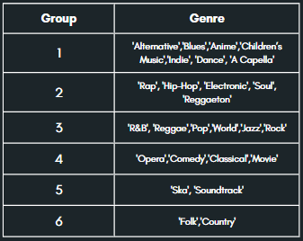
Result

Slide 6
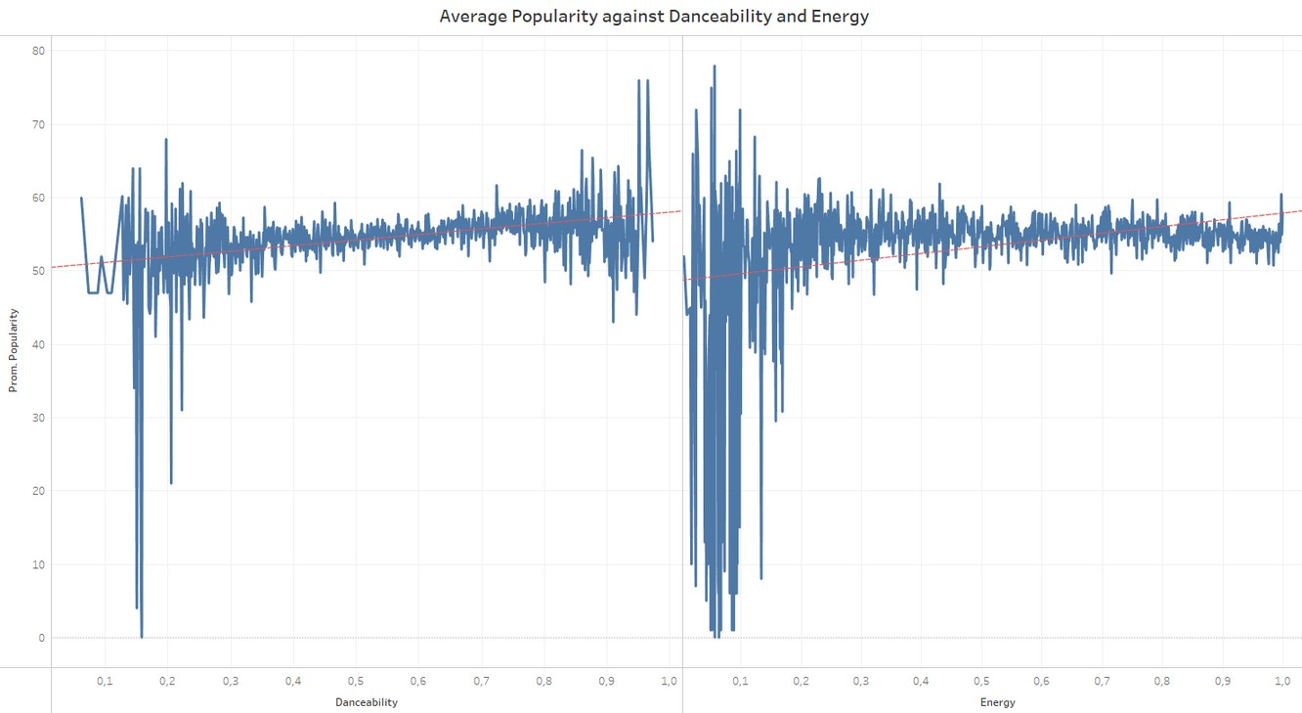
Group 1
'Alternative','Blues','Anime', 'Children’s Music','Indie', 'Dance', 'A Capella'
Influential features
Conclusion
Danceability between 0.35 and 0.75
Energy between 0.55 and 0.8
Model: Logistic Regression Recall: 58%
Notes:
Recall->discrimination capacity

Slide 7
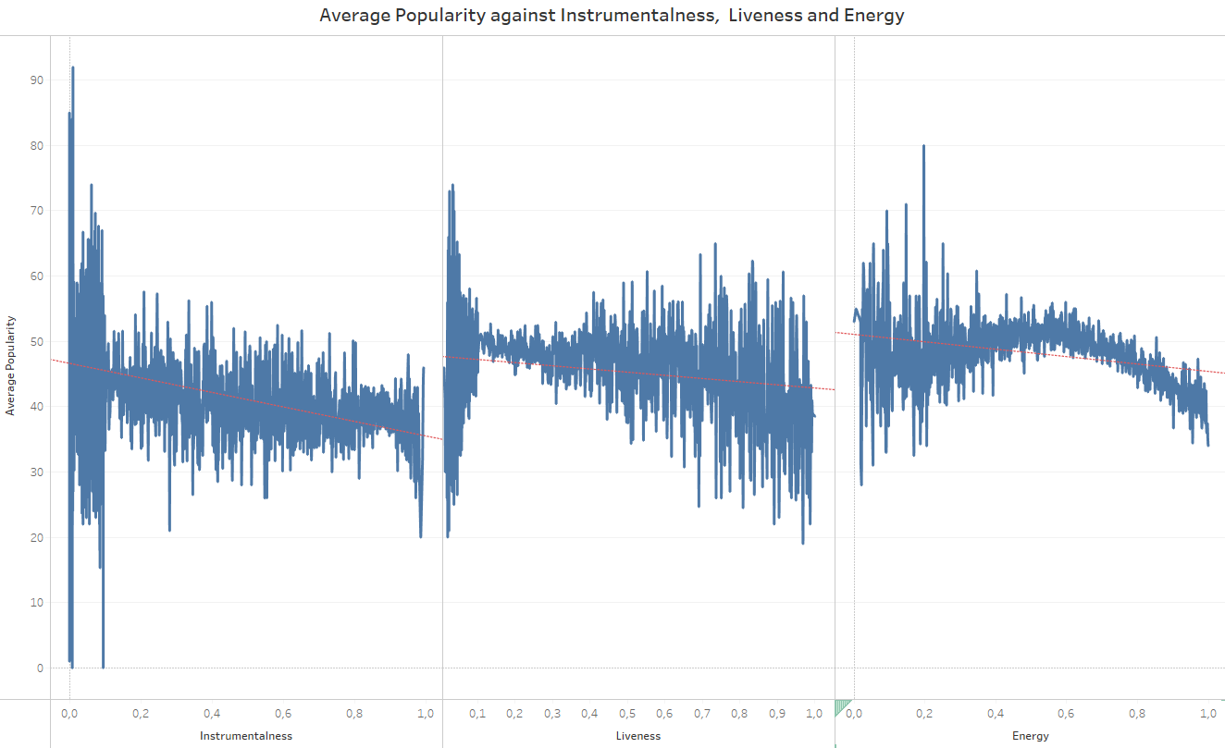
Group 2
'Rap', 'Hip-Hop', 'Electronic', 'Soul', 'Reggaeton'
Influential features
Conclusion
Liveliness between 0.15 and 0.3
Energy 0.41 and 0.7
Model: Logistic Regression Recall: 59%

Slide 8
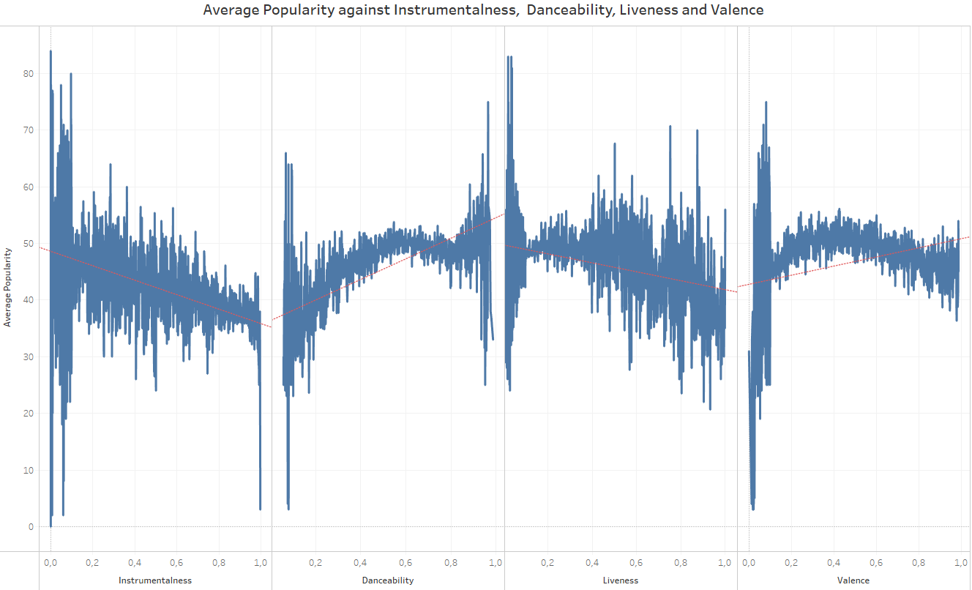
Group 3
'R&B', 'Reggae','Pop','World', 'Jazz','Rock'
Influential features
Conclusion
Danceability between 0.45 and 0.65
Model: Logistic Regression Recall: 62%

Slide 9
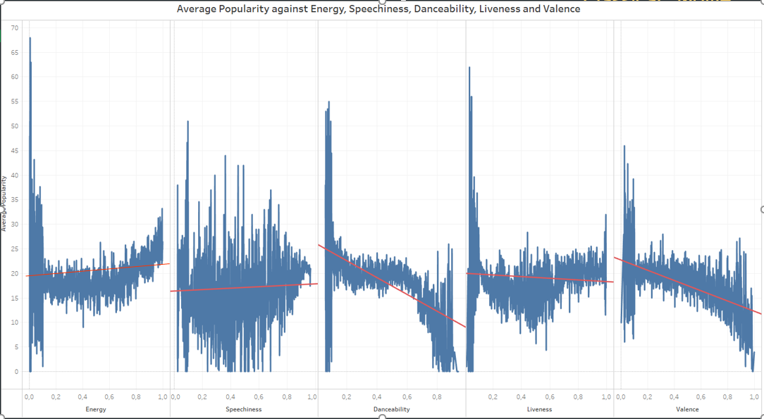
Group 4
'Opera','Comedy', 'Classical','Movie'
Influential features
Conclusion
Energy towards 1
Model: Logistic Regression Recall: 65%
Notes:
Descriptive note: has high speechiness

Slide 10
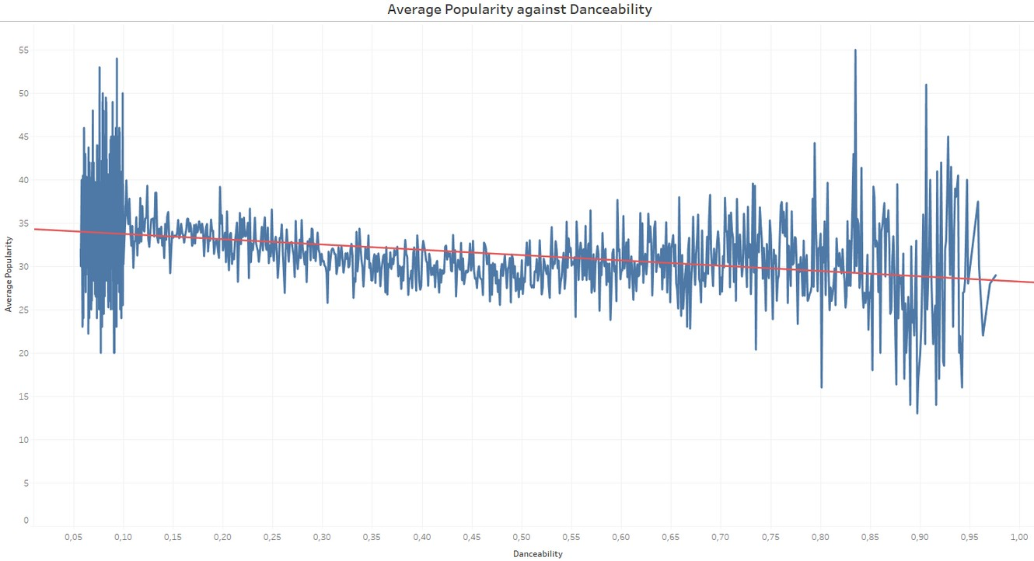
Group 5
'Ska', 'Soundtrack'
Influential features
Conclusion
Danceability between 0.13 and 0.20
Model: Logistic Regression Recall: 47%

Slide 11
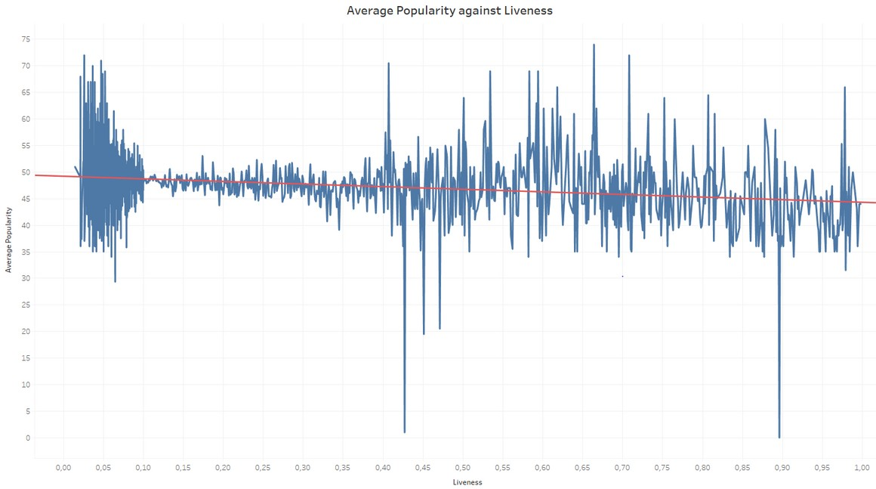
Group 6
'Folk','Country'
Influential features
Conclusion
Danceability between 0.10 and 0.18
Model: Logistic Regression Recall: 60%

Slide 12
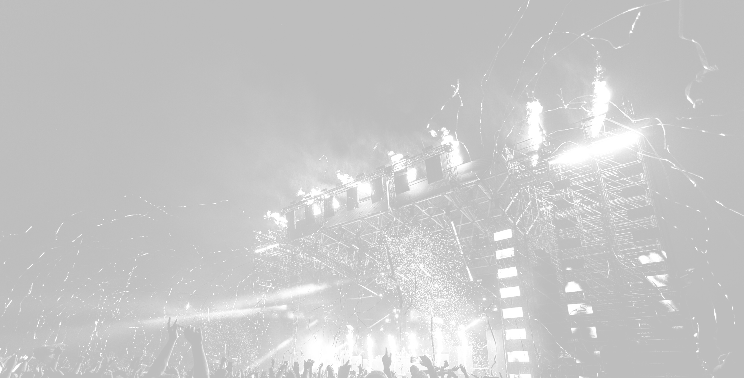
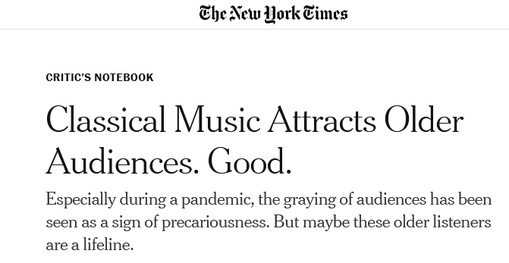
Project
CONCLUSIONS
Improvements
Difficult to predict a song’s popularity:
Overlap
Market volatile moods and trends
Group 4 shows more traceability:
Bigger data set to improve grouping
More in Depth study of:
Group 4 (increasing sample data)
Bands & Independent artists
Notes:
Bands and Independent artists:
that cover different genres and see their popularity levels

Slide 13

Thank you very much for your attention

